Slide 1


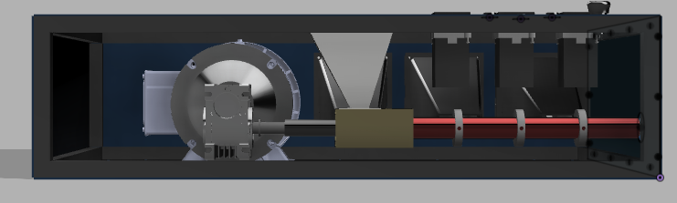
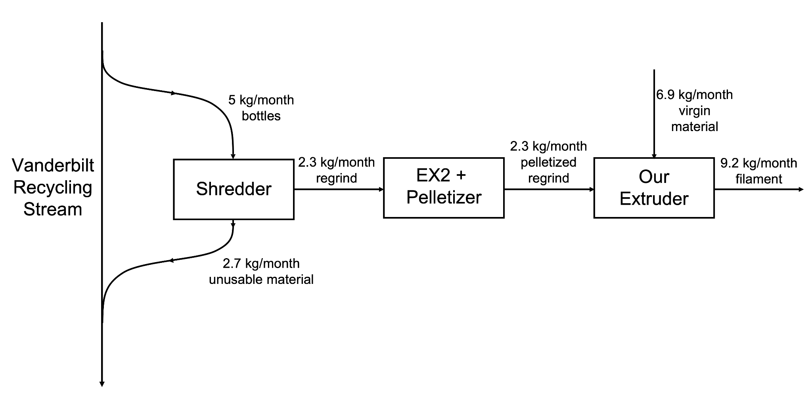
Recycled Polyethylene Terephthalate Filament Extruder
ChBE 01: Melanie Marszal, Amy Pang, Blake Christiansen, Sam Leville
Introduction & Background
CAD & Assembly
Process Economics
As sustainability grows increasingly important in our world, the Little Engineers That Could set out to create a circular plastics economy on Vanderbilt’s campus. We designed, modeled, and assembled an extruder that is capable of turning polyethylene terephthalate (PET) bottles from students into 3D printing filament for makerspaces across campus.
CAD
Before assembling our extruder, we created a full 3D model of it using Fusion 360. All parts were original models, imported from McMaster-Carr, or imported from GrabCAD.
Assembly
We obtained most of the parts for our extruder from McMaster-Carr and Amazon. We were able to 3D print smaller components. Specialty parts were machined by us or by a machine shop. By physically building our own extruder, we were able to perfect our prototype through multiple iterations of design. Our design is modular, so any part can be replaced or modified at any time.
Capital Investment
The Total Capital Investment, which is the sum the capital contributions to build and run the extruder, is $5,433.38.
Table 2. Key Costs and Revenue Sources
Cost/Revenue Source | Value | Cost/Revenue Source | Value
PETG Filament | $31.50 / kg | Storage Cost | $268.00 / 6 months
rPETG Pellets | $56.27 / 5 kg | Electricity | $0.1065 / kWh
Labor | $10.00 / hr / person | Amazon Fulfillment | $4.94 / kg
Product Shipping | $250.00 / 100 kg | Amazon Referral | 12% of revenue
Process Flow Diagram
Figure 2. Fusion 360 Rendering of Assembled Extruder
Extruder + Pelletizer
“Commercial” vs “As Needed” Approach
The “Commercial” approach assumes there is demand for filament that matches our maximum production rate (1.8 kg/hr). The profit for our extruder in this case is $5,000/year, resulting in a payback period of just over a year. If the cost of the extruder is considered a loan, it would take us 3 years and 7 months to payback our loan.
The “As Needed” approach assumes that our production rate matches the demand produced by the Digital Fabrication lab (~ 30 kg/year). Our extruder would save $776 per year.
Figure 1. Process Flow Diagram
Equipment & Sizing
Barrel Wall Thickness
The barrel wall must be a certain thickness in order to withstand the maximum simulated pressure experienced.
We found that with a barrel thickness of 0.479 in, a pressure of 865 psi, and an outer diameter of 1.109 in, the allowable stress is 1001 psi. The barrel is made from 12L14 steel which has a yield strength of 60,000 psi meaning our safety factor is around 60.
Motor and Gearbox Rating
The screw need around ¼ hp in order to extrude. We oversized the motor and purchased a ⅓ hp motor since this will be more capable in more situations. Gearbox is a 10:1 ratio.
Heaters
The heaters needed to be rated for the melting temperature of rPET (250 °C) and long enough to wrap the entire surface of the barrel.
Safety
The regrind-making process and assembly of the extruder highlighted health and safety concerns. We conducted a Hazard and Operability Analysis (HAZOP) and a Failure Mode and Effects Analysis (FMEA). From these analyses, the greatest hazards are summarized as follows:
Conclusion & Recommendations
The result of our project is a successfully built rPET extruder prototype. For future groups working on this project we recommend optimizing the barrel for higher throughput and integrating more process control mechanisms.
Table 1. Summary of Process Hazards
Hazard | Safeguard/Recommendation
High Barrel Pressure | Shear plate to absorb force, emergency stop button
Rotating Machinery | Hopper lid to cover opening, proper PPE
High Temperatures | PID controllers programmed to conservative setpoint values, emergency stop button
Acknowledgements
We would like to thank VU Plant Operations, VU Immersion, VU Chemical Engineering Department, Dr. Guelcher, Dr. Florian, and Skyler Hornback.

Slide 2

Extruder + Pelletizer
Figure 1. Process Flow Diagram

Slide 3
NEXTRUCAD Simulation Results
Result | Value
Output (kg/h) | 1.82
Max Pressure (MPa) | 5.97
Exit Temp (C) | 251.49
Melt Length (D) | 15.64
Power Consumption (kW) | 0.2
Torque (hp) | 0.26
Drag flow cap. (kg/h) | 3.14
Avg residence time (s) | 155.48
Barlow’s Equation
P = 2*𝝈*s / D
where P is the internal pressure, 𝝈 is the allowable stress of the material, s is the wall thickness, and D is the outer diameter of the barrel.

Slide 4
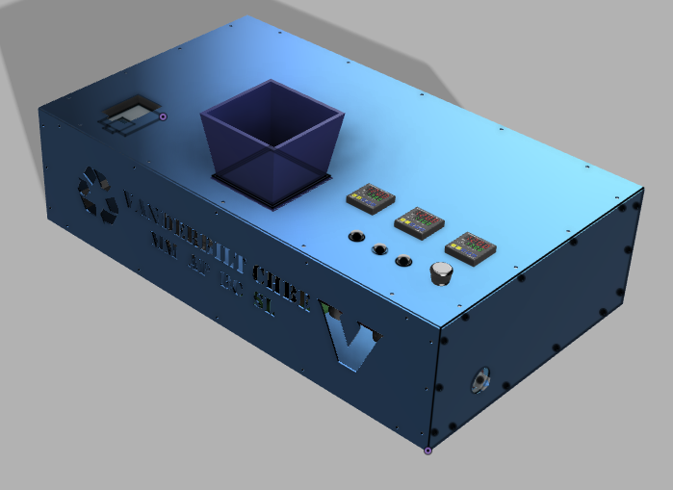

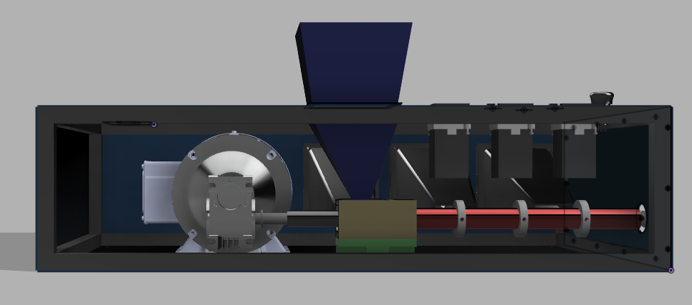
See interactive CAD models and a full list of parts here
Figure. Fusion 360 Extruder Rendering With Housing
Figure 2. Fusion 360 Side View Extruder Rendering

Slide 5
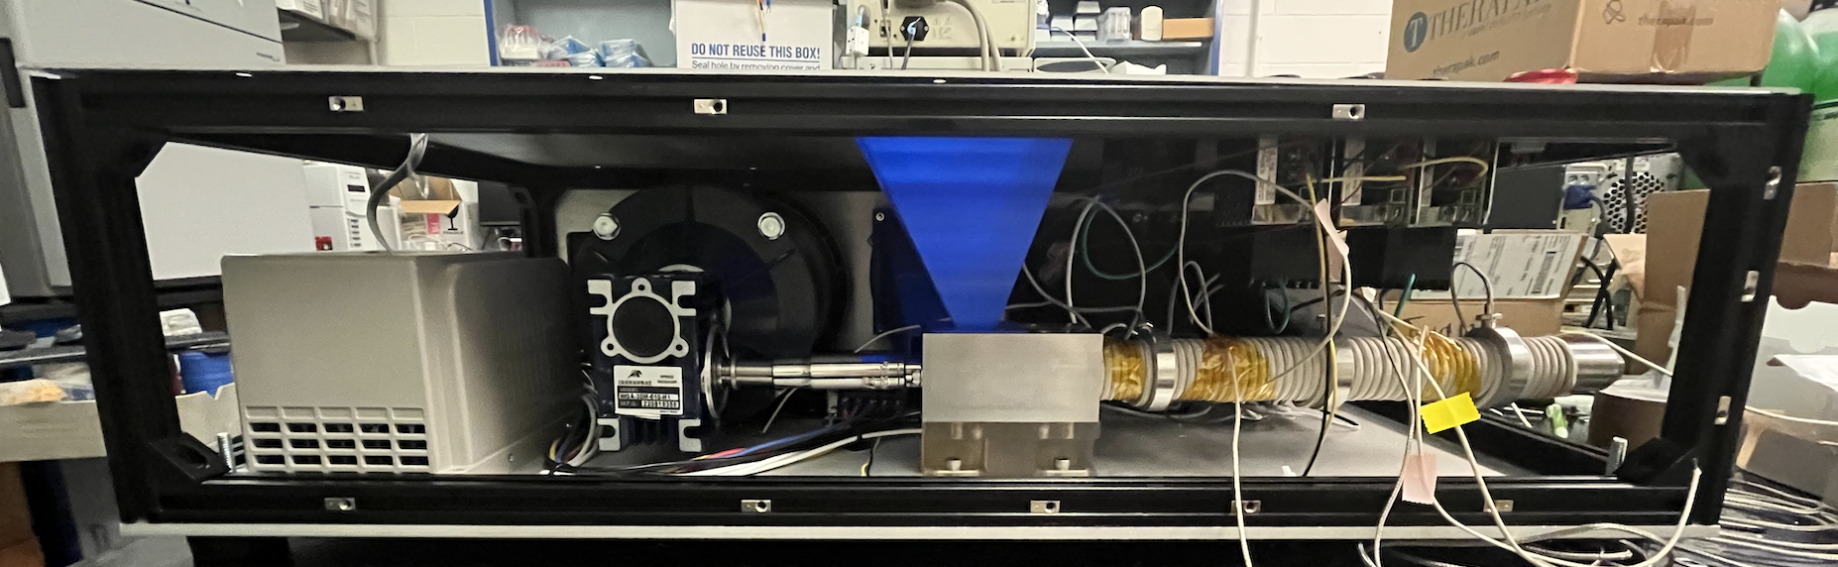
Figure. Side View of Built Extruder

Slide 6

Guide-Word | Guide-Word + Parameter | Cause | Consequence | Action
No | No flow through screw | Operator runs extruder without adding pellets to hopper; pellets clump together because of lack of heating | Galling may occur in which the metal screw and the metal barrel come into contact, causing damage to both. Pellet clumping may force the screw to become uncentered in which contact between the screw and barrel wall may occur too. | User manual outlines proper operational protocol; shear plate will break if pressure is too high, stopping screw from turning; operator shuts down machine via emergency stop button.
Other Than | Other than PET pellets | Foreign objects are accidentally dropped into hopper, which can damage the machinery and disrupt the process; Foreign objects like hair, clothing, or fingers get caught in the rotating screw. | Foreign materials can damage the screw and inner walls of the barrel. They can also affect the material properties and usability of the filament (product). They can prevent the flow in the screw, resulting in pressure build up in the screw and no product being extruded. Extreme damage and injuries can occur to the operator or whoever the foreign objects belong to, due to the power of the rotating machinery | Visual inspection of feed into the hopper, monitoring pressure and temperature sensors, metal detection of final product; operators or others on standby shut down the machine via emergency stop button and disconnect the power from the wall; user manual outlining safe attire and operation protocol.
More | More heating around screw | Heating unit not regulated; temperature PID set value is too high | Shear plate will break if pressure is too high and the break will be audible, allowing the operator shuts down machine via emergency stop button | PID controllers are programmed with a maximum set temperature of 270 C; in case of malfunction, operator shuts down machine via emergency stop button; fiberglass insulation wrapped around barrel.
As Well As | As well as exposed electrical components | Housing that protects electrical components are damaged | Operators risk electrocution. Damage can occur to the electric components, potentially damaging the extruder system as a whole | Visual inspection of the external extruder housing, visual inspection of external sensors for proper measurements.
Scan this QR code to view our full HAZOP on our website:

Slide 7
Process Step/Input | Potential Failure Mode | Potential Failure Effects | SEV | Potential Causes | OCC | Current Controls | DET | RPN
Making regrind | Non PET bottles are mixed into the bottle source | Filament has inconsistent chemical and material properties | 4 | Improper sorting of bottles | 3 | Check for #1 code on or near the bottom of the bottles to verify that they are made of PET. | 7 | 84
Barrel Pressure | Pressure inside the barrel exceeds the barrel's allowable pressure. | Filament can not be produced because no flow will continue through the barrel | 9 | Pellets do not melt and clog the barrel, resulting in backflow and a buildup of pressure | 2 | A shear plate is located on the output shaft, so that if the screw begins to move backwards the shear plate will break. | 7 | 126
Heating | Heating temperatures are far above the specified temperatures. | Filament being produced has a low viscosity, changing the strength properties. | 7 | Temperature PID controllers malfunction or are not tuned correctly. | 2 | Final filament temperature is monitored by a temperature sensor | 4 | 56
Electronic Wiring | Wiring is not done correctly. | Entire machine could be damaged | 10 | Improper wiring from manufacturers | 2 | Operators check the wiring of each individual component of the extruder. | 3 | 60
Feeding Raw Materials | Objects other than PET pellets enter the hopper, with special concern for hair, clothing, and body parts getting caught in the machinery. | Operators could be seriously injured or be fatally harmed if hair, clothing, or body parts are caught in the screw. | 10 | Proper PPE is not worn by the operators and the hopper is not covered pellets are not being fed. | 4 | Hopper should be covered with a lid when pellets are not being added to the hopper. | 10 | 400
Screw Stability | The screw wobbles or slants within the barrel. | The inside of the barrel could be scraped, decreasing its pressure rating and potentially causing the barrel to rupture. | 10 | Pellets are not fed to the running extruder, the screw is not securely attached to the coupler. | 2 | A bearing is placed on the end of the screw where it enters the flange to ensure stability | 3 | 60
Fan | Power to the fan is shuts off. | Internal components of the extruder such as the barrel and electronics are overheated. | 8 | Wires short circuit or power plug is damaged, resulting in the fans to turn off. | 2 | Fiberglass insulation is placed around the barrel to trap and isolate the heat around the barrel and prevent the rest of the extruder from getting too hot. | 5 | 80

Slide 8
Table. Total Capital Investment Breakdown
Equipment Type | Cost
Motor Train (Screw, Motor, Gear Box, etc.) | $1,558.99
Electrical (VFD, Power Supplies, wires, etc.) | $291.36
Heating/Cooling (Heaters, Fans, PID, etc.) | $1,024.42
Structure (Housing, Aluminium Extrusion, etc.) | $1,082.31
Machining (Taps, Lathe Turning, etc.) | $1,084.86
3D Printing Material | ~ $0
Prototyping Risk | $391.44
Total Capital Investment | $5,433.38

Slide 9
Table 2. Key Costs and Revenue Breakdown
Cost/Revenue Source | Value | Cost/Revenue Source | Value
PETG Filament | $31.50 / kg | Storage Cost | $268.00 / 6 months
PETG Pellets | $56.27 / 5 kg | Electricity | $0.1065 / kWh
Labor | $10.00 / hr / person | Amazon Fulfillment | $4.94 / kg
Product Shipping | $250.00 / 100 kg | Amazon Referral | 12% of revenue

Slide 12
Commercial Approach
No property or unit operations costs
The extruder is run during the standard Vanderbilt school year which we estimate as 30 weeks per year
The extruder is operated by a single undergraduate student who works the 19 hours per week at $10.00 per hour
Power consumption will be charged to the Digital Fabrication Lab at a rate of $0.1065 / kWh
The business is being run through Amazon sale thus incurring Amazon’s storage, fulfillment, and referral fees as listed in Table 2; and
100% of our product is usable and sold

Slide 13
As Needed Approach
Commercial price of 1 kg of PETG filament is $31.50
Cost to produce 1 kg of our filament is $5.36
The Digital Fabrication Lab uses about 30 kg of PETG filament per year and will switch over completely to the Vanderbilt-sourced rPETG filament;
The electrical cost to run the extruder is negligible;
And the extruder will be run by an unpaid undergraduate student.
Saves the Digital Fabrication Lab $776/year

Slide 14
